Slide 1

EEE-2421: Electrical Drives and Instrumentation Credit Hours - 2 Segment - 6
Saif Sabbir
Lecturer
Department of CSE
International Islamic University Chittagong (IIUC)
Spring 2026

Slide 2
BASIC CONCEPTS OF INSTRUMENTATION AND MEASUREMENT
1.1 Classification of instruments
    Analog instrument
The measured parameter value is display by the moveable pointer. The pointer will moved continuously with the variable parameter/analog signal which is measured. The reading is inaccurate because of parallax error (parallel) during the skill reading. E.g: ampere meter, voltage meter, ohm meter etc.
    Digital instrument
The measured parameter value is display in decimal (digital) form which the reading can be read thru in numbers form. Therefore, the parallax error is not existed and terminated. The concept used for digital signal in a digital instrument is logic binary ‘0’and ‘1’.

Slide 3
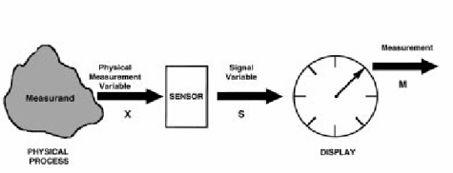
  1.2 Characteristic of instruments
Figure 1.1 presents a generalized model of a simple instrument. The physical process to be measured is in the left of the figure and the measurand is represented by an observable physical variable X.
Figure 1.1: Simple instrument model.
For example, the mass of an object is often measured by the process of weighing, where the measurand is the mass but the physical measurement variable is the downward force the mass exerts in the Earth’s gravitational field. There are many possible physical measurement variables.

Slide 4
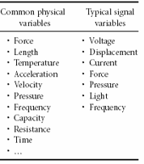
The key functional element of the instrument model shown in Figure 1.1 is the sensor, which has the function of converting the physical variable input into a signal variable output.
Signal variables have the property that they can be manipulated in a transmission system, such as an electrical or mechanical circuit. Because of this property, the signal variable can be transmitted to an output or recording device that can be remote from the sensor. In electrical circuits, voltage is a common signal variable. In mechanical systems, displacements or force are commonly used as signal variables. Other examples of signal variable are shown in Table 1.1.
Table 1.1: Example physical variables

Slide 5
The signal output from the sensor can be displayed, recorded, or used as an input signal to some secondary device or system. In a basic instrument, the signal is transmitted to a Display or recording device where the measurement can be read by a human observer. The observed output is the measurement M.
There are many types of display devices, ranging from simple scales and dial gages to sophisticated computer display systems. The signal can also be used directly by some larger system of which the instrument is a part.
Two basic characteristic of an instrument is essential for selecting the most suitable instrument for specific measuring jobs:
  Static characteristic
  Dynamic characteristic
Static characteristic of an instrument are, in general, considered for instruments which are used to measure an unvarying process condition.

Slide 6
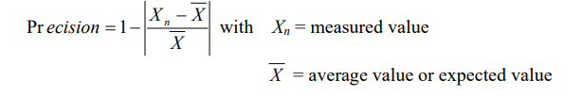
Several terms of static characteristic that have discussed:
  Instrument – A device or mechanism used to determine the present value of a quantity under observation.
  Measurement – The process of determining the amount, degree, capacity by comparison (direct or indirect) with the accepted standards of the system units being used.
  Accuracy – The degree of exactness (closeness) of a measurement compared to the expected (desired) value.
  Resolution – The smallest change in a measured variable to which instruments will response. Also known as ‘Threshold’.
  Precision – A measure of consistency or repeatability of measurements, i.e. successive readings do not differ or the consistency of the instrument output for a given value of input. A very precise reading though is not perfectly an accurate reading.

Slide 7

  6. Expected value – The design value that is, “most probable value” that calculations indicate one should expect to measure.
  7. Hysterisis – The different loading and unloading curve due to the magnetic hysterisis of the iron. E.g.: Occur to a moving iron voltmeter, it is slowly varies from zero to full scale value and then back to zero; the input-output curve will be different.
  8. Dead Zone/band – The total range of possible values for instrument will not given a reading even there is changes in measured parameter.
  9. Nominal value - Is some value of input and output that had been stated by the manufacturer for user manual.
  10. Bias – A constant error that occur to instrument when the pointer not starting from zero scale.
  11. Range – A minimum and maximum range for instrument to operate and it is stated by the manufacturer of the instrument.
  12. Sensitivity – The ratio of the change in output (response) of the instrument to a change of input or measured variable
  Dynamic characteristic are concerned with the measurement of quantities that vary with time

Slide 8
  1.3 Process of measurement
Measurement is essentially the act, or the result, of a quantitative comparison between a given quantity and a quantity of the same kind chosen as a unit. The result of measurement is expressed by a number representing the ratio of the unknown quantity to the adopted unit of measurement.
The step taken before measure:
Procedure of measurement: Identified the parameter or variable to be measured, how to record the result
Characteristic of parameter: Should know the parameter that to be measured; ac, dc, frequency or etc.
Quality: Time and cost of equipment, the instrument ability, the measurement knowledge and suitable result.
Instrument: Choose a suitable equipment; multimeter, voltmeter, oscilloscope or etc.

Slide 9
During measurement:
Quality: Make sure the chosen, instrument is the best, the right position when taken result, the frequent of measurement.
Safety first: Electric shock, overload effect, limitation of instrument.
Sampling: See the changing of parameter during measurement, which value should be taken when the parameter keep changing. Take enough samples and it is accepted.
The step taken after measurement:
Every data recorded must be analysed, statically, mathematically and the result must be accurately and completed.

Slide 10
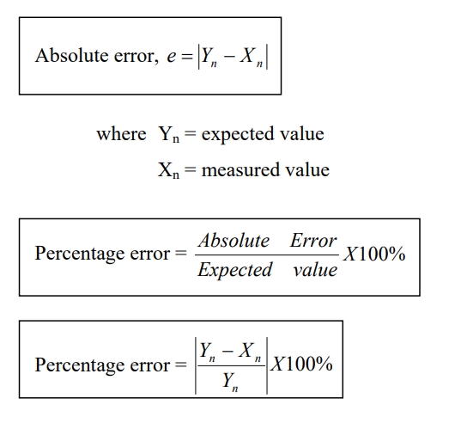
1.4 Error in measurement
Error is defined as the difference between the true value (expected value) of the measurand and the measured value indicated by the instrument.
Error may be expressed either as absolute error or as a percentage of error.
Absolute errors are defined as the difference between the expected value of the variable and the measured value of variable.

Slide 11
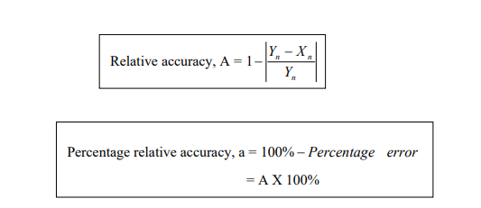
Example 1:
The expected value of the voltage across a resistor is 90 V. However, the measurement gives a value of 89 V.
Calculate:
a) Absolute error
b) Percentage error
c) Relative accuracy
d) Percentage of accuracy
Solution:
Expected value of voltage across a resistor, Yn = 90 V
Measured value of voltage across a resistor, Xn = 89 V

Slide 12
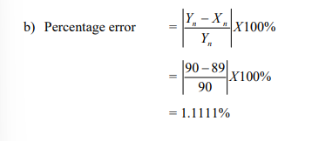
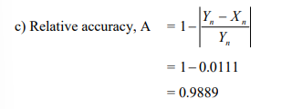
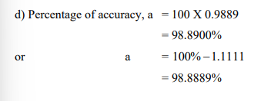
  a) Absolute error ,e = Yn – Xn
  =90 – 89
  =1 V

Slide 13
1..5 Types of error
Errors are generally categories under the following three major heating:
Gross Errors - Is generally the fault of the person using instruments and are due to such things as incorrect reading of instruments, incorrect recording of experimental data or incorrect use of instrument.
2. Systematic Errors – are due to problems with instruments, environment effects or observational errors.
  Instrument errors – It is due to friction in the bearings of the meter movement, incorrect spring tension, improper calibration, or faulty instruments.
  Environmental errors – Environmental conditions in which instruments are used may cause errors. Subjecting instruments to harsh environments such high temperature, pressure, humidity, strong electrostatic or electromagnetic fields, may have detrimental effects, thereby causing error.

Slide 14
  Observational errors - Those errors that introduced by observer. Two most common observational errors are probably the parallax error introduced in reading a meter scale and error of estimation when obtaining a reading from a scale meter.
3. Random Errors – are generally the accumulation of a large number of small effects and may be of real concern only in measurements requiring a high degree of accuracy. Such errors can be analyzed statistically.

Slide 15
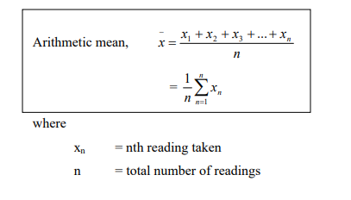
1.6 Statistical analysis of error in measurement
How to analyze an error?
- use statistic method
When we measure any physical quantity, our measurements are effected by a multitude of factors.
Arithmetic mean – the sum of a set of numbers divided by the total number of pieces of data.

Slide 16

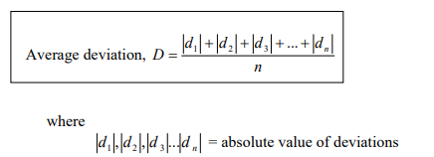
Deviation – the difference each piece of test data and the arithmetic mean.
Note: The algebraic sum of the deviations of a set numbers from their arithmetic mean is zero.
The average deviation is an indication of the precision of the instrument used in measurement or the sum of the absolute values of the deviation divided by the number of readings.

Slide 17

The standard deviation is the square root of the sum of all the individual deviations squared, divided by the number of readings.
*** For small readings (n<30), the denominator is n - 1

Slide 18
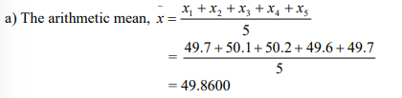
Example:
For the following given data, calculate
  Arithmetic mean
  Deviation of each value
  Algebraic sum of the deviations
  Calculate the average deviation (Ans: 0.232)
  Calculate the standard deviation (Ans: 0.27)
Solution:

Slide 19
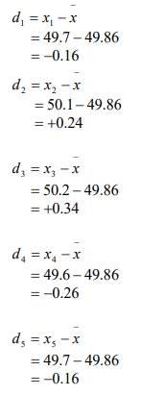
b) The deviations from each value are given by

Slide 20

c) Average deviation, D =
d) Standard deviation, σ =

Slide 21
1.7 Limiting error
Most manufacturers of measuring instrument state that an instrument is accurate within a certain percentage of a full-scale reading.
For example, the manufacturer of a certain voltmeter may specify the instrument to be accurate within ± 2% with full-scale deflection.

Slide 22



1.8 Measurement error combinations
When a quantity is calculated from measurements made on two ore more instruments, it must be assumed that errors due to instrument inaccuracy combine in worst possible way. The resulting error is then larger than the error in any one instrument.
Sum of quantities:
Difference of quantities:
Product of quantities:

Slide 23


Quotient of quantities:
Quantity raised to a power:

Slide 24
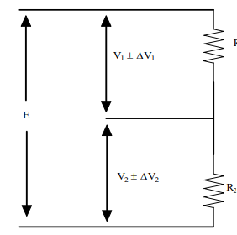

Sum of Quantities
Where a quantity is determined as the sum of two measurements, the total error is the sum of the absolute errors in each measurement. As illustrated in Figure 1.2:
Figure 1.2: Error in sum of quantities equals sum of errors

Slide 25
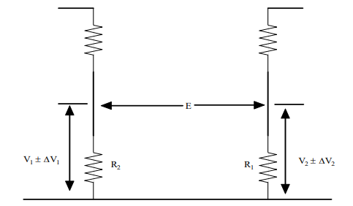

Difference of Quantities
Figure 1.3 illustrated a situation in which a potential difference is determined as the difference between two measured voltages. Here again, the errors are additive;
Figure 1.3: Error in difference of quantities equals sum of errors

Slide 26
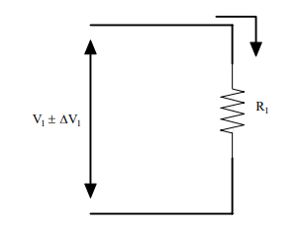

Product of Quantities
When a calculated quantity is product of two or more quantities, the percentage error is the sum of the percentage errors in each quantity
Figure 1.4: Percentage error in product or quotient of quantities equals sum of percentage

Slide 27

Quotient of Quantities
Here again it can be that the percentage error is the sum of the percentage errors in each quantity
Quantity Raised to a Power
When a quantity A is raised to a power B, the percentage error in A^{B} can be shown to be: Percentage error in A^{B} = B (% error in A)

Slide 28

Problems
Example:
A 600V voltmeter is specified to be accurate within ± 2% at full scale. Calculate the limiting error when the instrument is used to measure a voltage of 250V.
Solution :
The magnitude of the limiting error is 0.02 X 600 = 12 V
Example:
A voltmeter reading 70V on its 100V range and an ammeter reading 80mA on its 150mA range are used to determine the power dissipated in a resistor. Both these instruments are guaranteed to be accurate within ± 1.5% at full-scale deflection. Determine the limiting error of the power. (Ans: 4.956%)

Slide 29
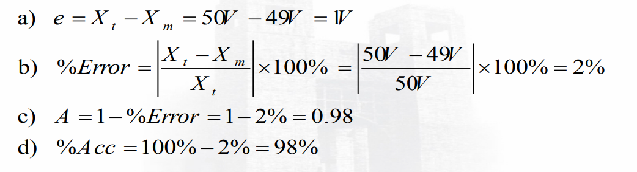
Problems
  Example The expected value of the voltage across a resistor is 50 V. However, the measurement gives a value of 49 V.
  Find:
  Absolute error b) % error c) Relative accuracy d) % accuracy
  Solution:

Slide 30
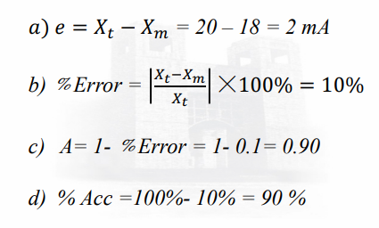
Problems
  Example The expected value of the current through a resistor is 20 mA. However, the measurement yields a current value of 18 mA.
  Calculate:
  Absolute error b) % error c) Relative accuracy d) % accuracy
  Solution:

Slide 31
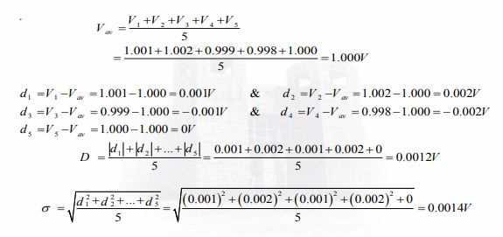
Problems
  Example The accuracy of five digital voltmeters are checked by using each of them to measure a standard 1.0000V from a calibration instrument. The voltmeter readings are as follows: V1 = 1.001 V, V2 = 1.002, V3 = 0.999, V4 = 0.998, and V5 = 1.000. Calculate the average measured voltage, the average deviation, and the standard deviation.
  Solution:

Slide 32
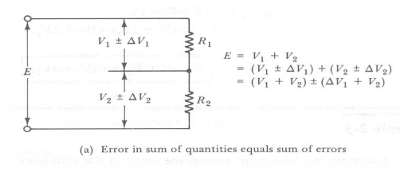
Measurement Error Combinations
Sum of Quantities
When a quantity is determined as the sum of two measurements, the total error is the sum of the absolute errors in each measurement.
Difference of Quantities
The error of the difference of two measurements are again additive

Slide 33
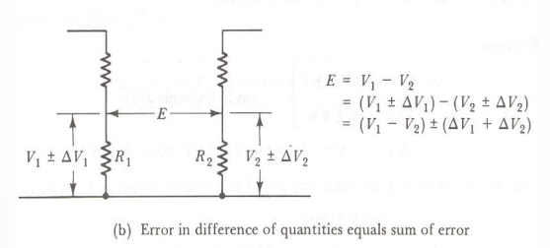
Measurement Error Combinations
Product of Quantities
When a calculated quantity is the product of two or more quantities, the percentage error is the sum of the percentage errors in each quantity

Slide 34
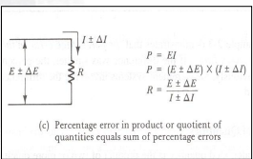
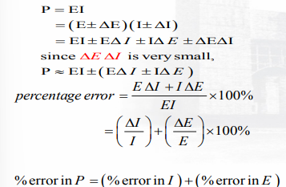


Measurement Error Combinations
Quotient of Quantities
Quantity Raised to a Power

Slide 35
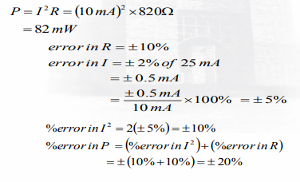
Measurement Error Combinations
Example: An 820Ω resistance with an accuracy of ±10% carries a current of 10 mA. The current was measured by an analog ammeter on a 25mA range with an accuracy of ±2% of full scale. Calculate the power dissipated in the resistor, and determine the accuracy of the result.
Solution:

